Slide 1
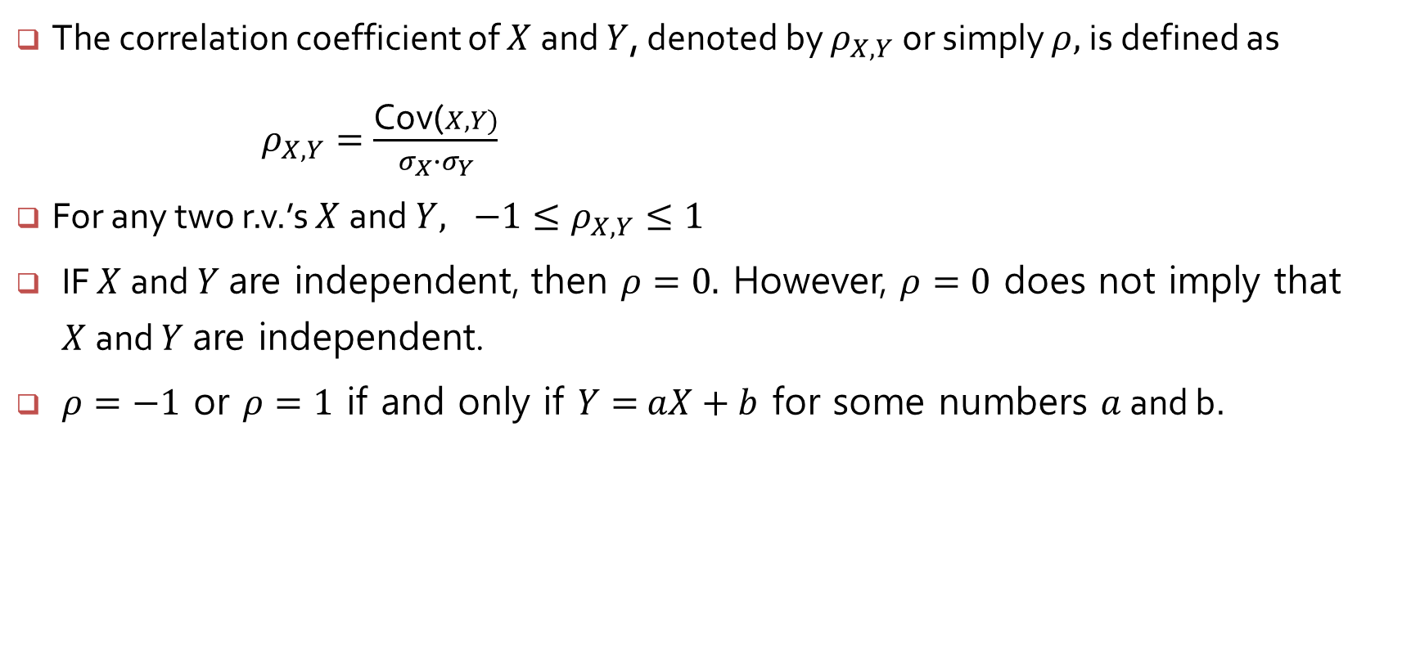
Correlation
The correlation coefficient of $X$and $Y$, denoted by $ρ_{X,Y}$or simply $ρ,$is defined as
$ρ_{X,Y}=\frac{\text{Co}\text{v}\text{(}X, Y)}{σ_{X}{∙σ}_{Y}}$
For any two r.v.’s $X$and $Y, −1≤ρ_{X,Y}≤1$
IF $X$and $Y$are independent, then $ρ=0.$ However, $ρ=0$ does not imply that $X$and $Y$are independent.
$ρ=−1$ or $ρ=1$ if and only if $Y=$ $aX+b$ for some numbers $a$ and b.

Slide 2
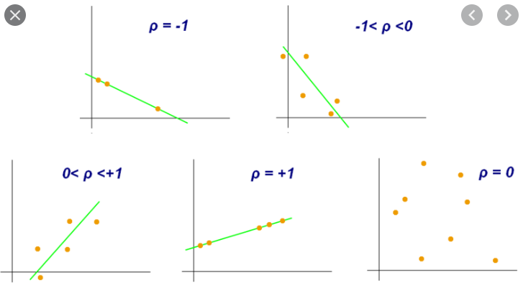

Slide 3
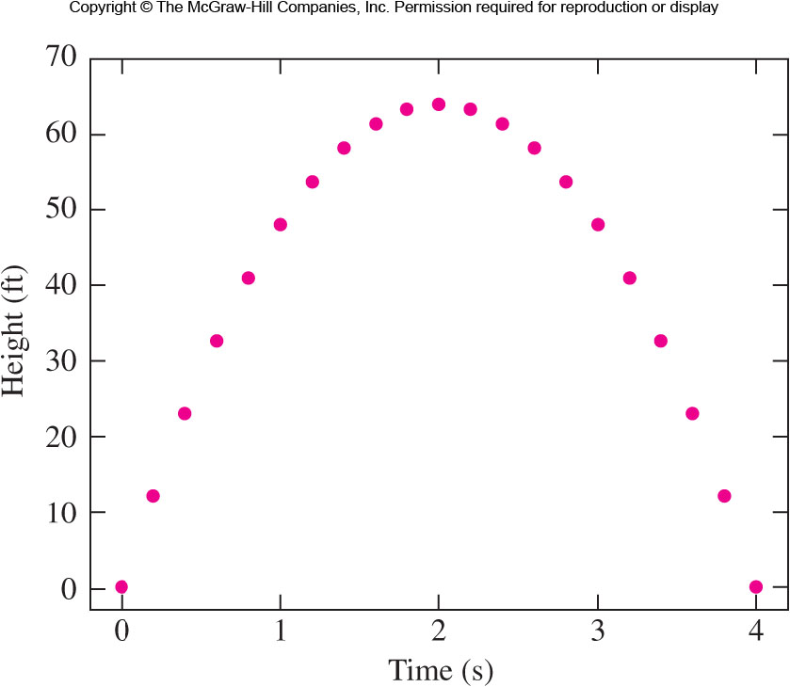
An object is fired upward from the ground. The relationship between the height of a free falling object and the time.
Correlation coefficient : 0

Slide 4
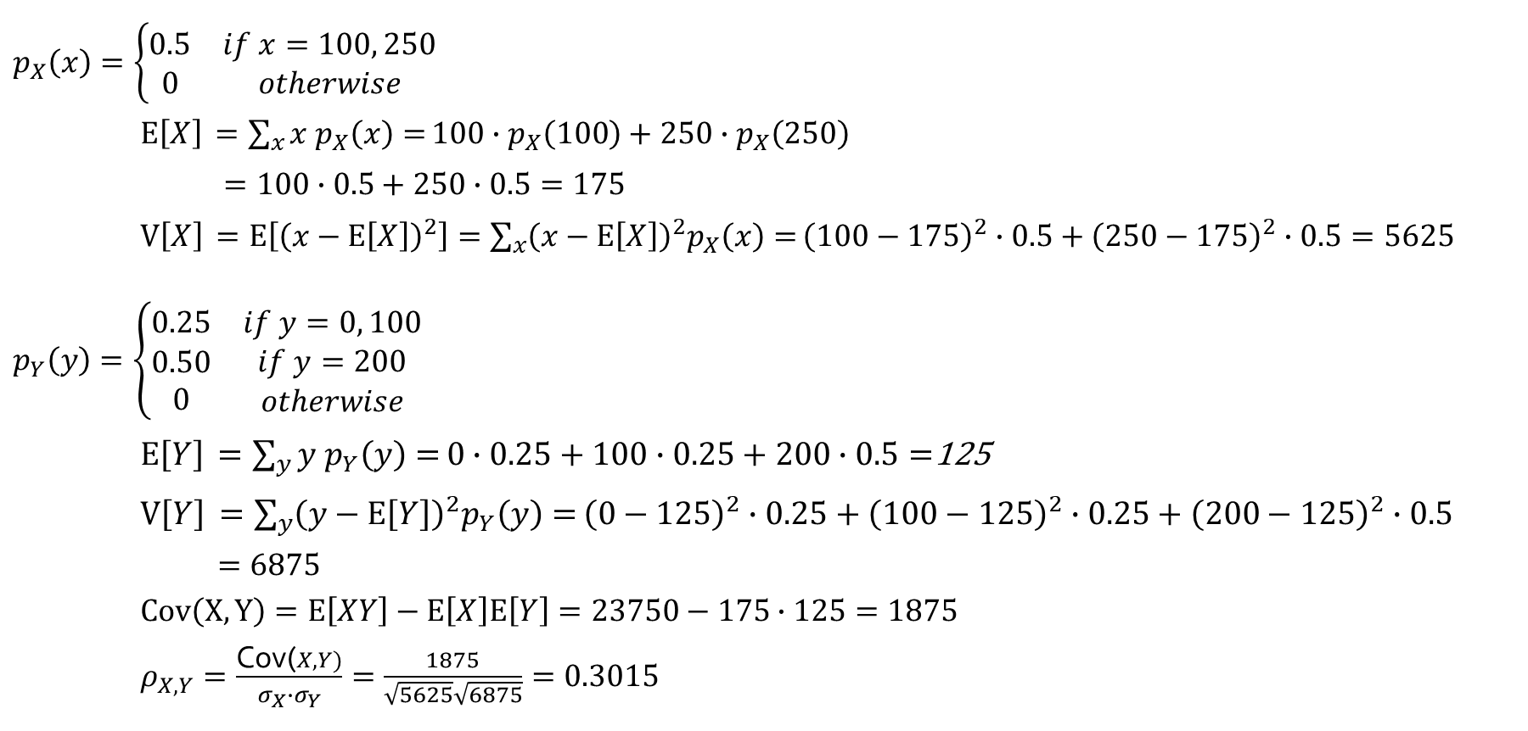
Example 5.17
y
 |  | 0 | 100 | 200
x | 100 | 0.20 | 0.10 | 0.20
 | 250 | 0.05 | 0.15 | 0.30
$p_{X}\left(x\right)=\left\{\begin{matrix}0.5 & if x=100, 250 \\ 0 & otherwise\end{matrix}\right.$
$E\left[X\right]$ $=\sum_{x}{x p_{X}\left(x\right)=}100∙p_{X}\left(100\right)+250∙p_{X}\left(250\right)$
$=100∙0.5+250∙0.5=175$
$V\left[X\right]$ $=E\left[{\left(x−E\left[X\right]\right)}^{2}\right]=\sum_{x}{{\left(x−E\left[X\right]\right)}^{2}p_{X}\left(x\right)=}{\left(100−175\right)}^{2}∙0.5+{\left(250−175\right)}^{2}∙0.5=5625$
$p_{Y}\left(y\right)=\left\{\begin{matrix}0.25 & if y=0, 100 \\ \begin{matrix}0.50 \\ 0\end{matrix} & \begin{matrix}if y=200 \\ otherwise\end{matrix}\end{matrix}\right.$
$E\left[Y\right]$ $=\sum_{y}{y p_{Y}\left(y\right)=}0∙0.25+100∙0.25+200∙0.5=$125
$V\left[Y\right]$ $=\sum_{y}{{\left(y−E\left[Y\right]\right)}^{2}p_{Y}\left(y\right)=}{\left(0−125\right)}^{2}∙0.25+{\left(100−125\right)}^{2}∙0.25+{\left(200−125\right)}^{2}∙0.5$
$=6875$
$Cov\left(X, Y\right)=E\left[XY\right]−E\left[X\right]E\left[Y\right]=23750−175$ $∙125=1875$
$ρ_{X,Y}=\frac{\text{Cov}\text{(}X, Y)}{σ_{X}{∙σ}_{Y}}=\frac{1875}{\sqrt{5625}\sqrt{6875}}=0.3015$

Slide 5
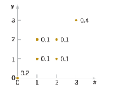
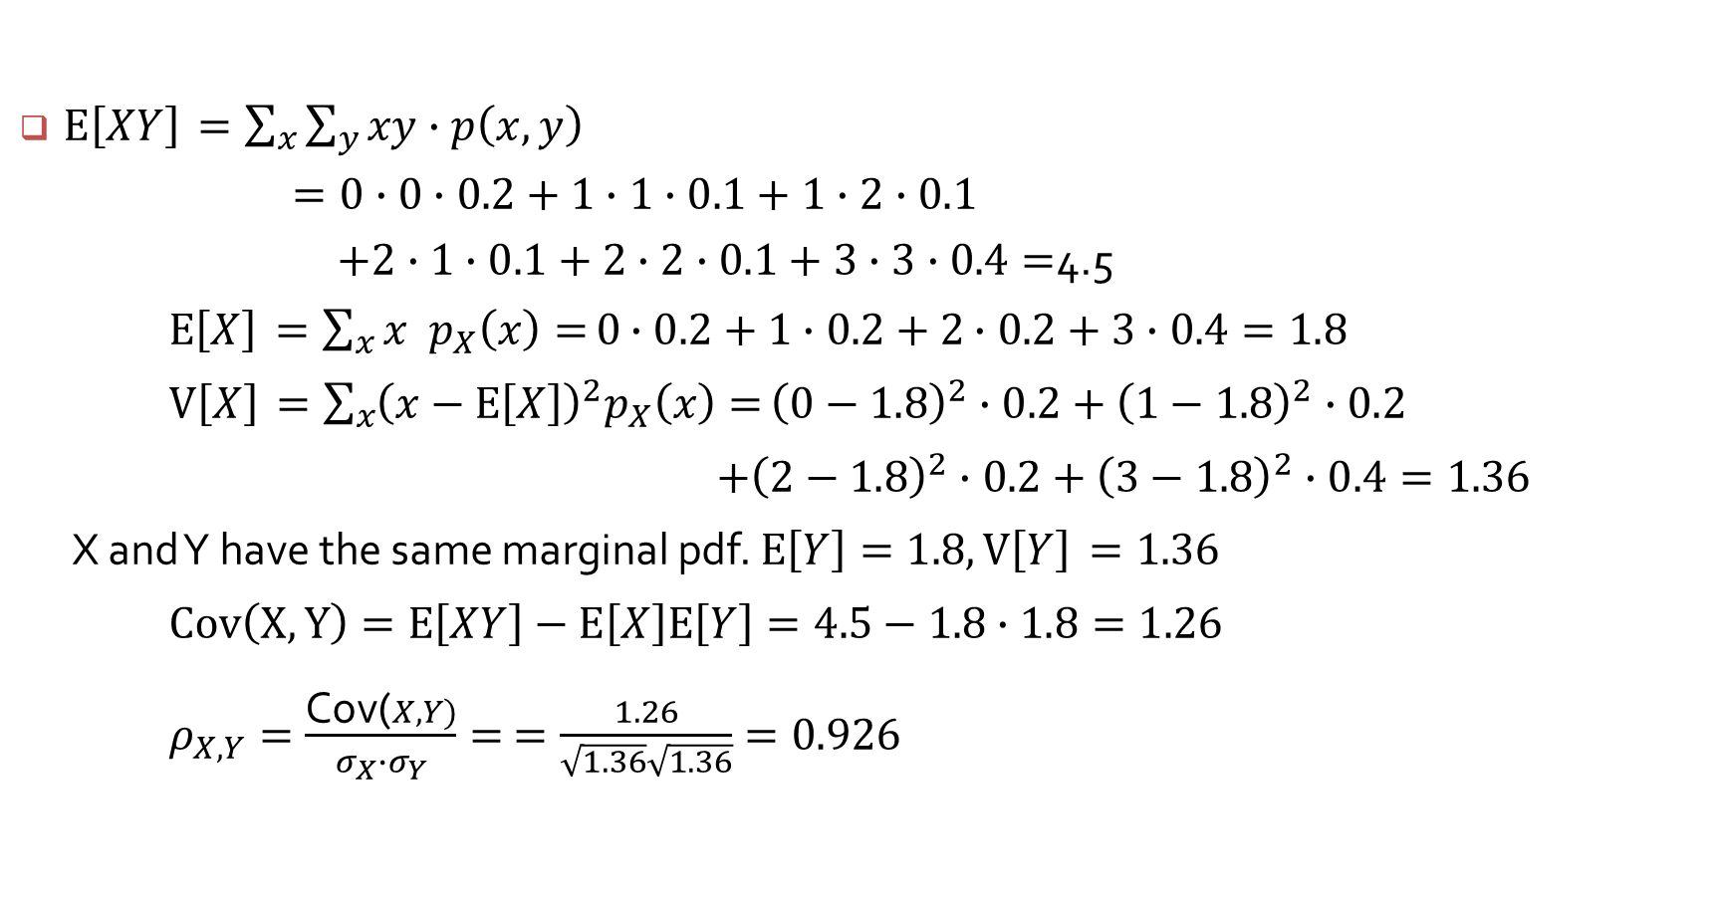
Example
$E\left[XY\right]$ $=\sum_{x}{\sum_{y}{xy∙p\left(x, y\right)}}$
$=0∙0∙0.2+1∙1∙0.1+1∙2∙0.1$
$+2∙1∙0.1+2∙2∙0.1+3∙3∙0.4=$4.5
$E\left[X\right]$ $=\sum_{x}{{x p}_{X}\left(x\right)=}0$ $∙0.2+1∙0.2+2$ $∙0.2+3∙0.4=1.8$
$V\left[X\right]$ $=\sum_{x}{{\left(x−E\left[X\right]\right)}^{2}p_{X}\left(x\right)=}{\left(0−1.8\right)}^{2}∙0.2+{\left(1−1.8\right)}^{2}∙0.2$
$+{\left(2−1.8\right)}^{2}∙0.2+{\left(3−1.8\right)}^{2}∙0.4=1.36$
X and Y have the same marginal pdf. $E\left[Y\right]=1.8, V\left[Y\right]$ $=1.36$
$Cov\left(X, Y\right)=E\left[XY\right]−E\left[X\right]E\left[Y\right]=4.5−1.8$ $∙1.8=1.26$
$ρ_{X,Y}=\frac{\text{Cov}\text{(}X, Y)}{σ_{X}{∙σ}_{Y}}=$ $=\frac{1.26}{\sqrt{1.36}\sqrt{1.36}}=0.926$

Slide 6

Example
$E\left[XY\right]$ $=\sum_{x}{\sum_{y}{xy∙p\left(x, y\right)}}$
$=0∙0∙0.2+1∙1∙0.1+1∙2∙0.1$
$+2∙1∙0.1+2∙2∙0.1+3∙3∙0.4=$4.5
$E\left[X\right]$ $=\sum_{x}{p_{X}\left(x\right)=}0$ $∙0.2+1∙0.2+2$ $∙0.2+3∙0.4=1.8$
$V\left[X\right]$ $=\sum_{x}{{\left(x−E\left[X\right]\right)}^{2}p_{X}\left(x\right)=}{\left(0−1.8\right)}^{2}∙0.2+{\left(1−1.8\right)}^{2}∙0.2$
$+{\left(2−1.8\right)}^{2}∙0.2+{\left(3−1.8\right)}^{2}∙0.4=1.36$
X and Y have the same marginal pdf. $E\left[Y\right]=1.8, V\left[Y\right]$ $=1.36$
$Cov\left(X, Y\right)=E\left[XY\right]−E\left[X\right]E\left[X\right]=4.5−1.8$ $∙1.8=1.26$
$ρ_{X,Y}=\frac{\text{Cov}\text{(}X, Y)}{σ_{X}{∙σ}_{Y}}=$ $=\frac{1.26}{\sqrt{1.36}\sqrt{1.36}}=0.926$

Slide 7
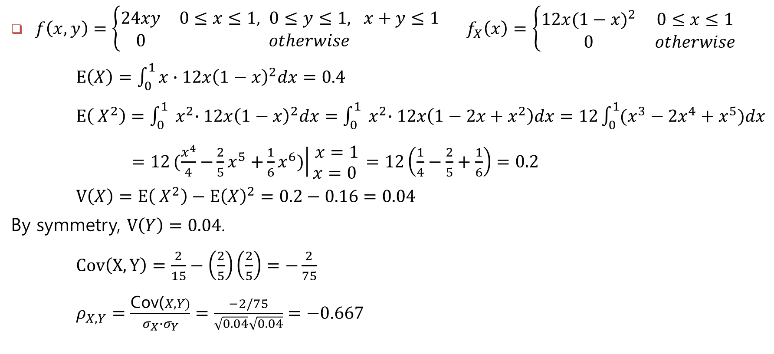
$f\left(x, y\right)=\left\{\begin{matrix}24xy & 0≤x≤1, 0≤y≤1, x+y≤1 \\ 0 & otherwise\end{matrix}\right.$ $f_{X}\left(x\right)=\left\{\begin{matrix}12x{(1−x)}^{2} & 0≤x≤1 \\ 0 & otherwise\end{matrix}\right.$
$E\left(X\right)=\int_{0}^{1}{x∙12x{\left(1−x\right)}^{2}dx}=0.4$
$E\left({ X}^{2}\right)=\int_{0}^{1}{{ x}^{2}∙12x{\left(1−x\right)}^{2}dx}=\int_{0}^{1}{{ x}^{2}∙12x\left(1−2x+{ x}^{2}\right)dx}=12\int_{0}^{1}{(x^{3}−2x^{4}+x^{5})dx}$
$=12\left.(\frac{x^{4}}{4}{−\frac{2}{5}x}^{5}{+\frac{1}{6}x}^{6})\right|\begin{matrix}x=1 \\ x=0 \end{matrix}=12\left(\frac{1}{4}−\frac{2}{5}+\frac{1}{6}\right)=0.2$
$V\left(X\right)=E\left({ X}^{2}\right)−{E\left(X\right)}^{2}=0.2−0.16=0.04$
By symmetry, $V\left(Y\right)=0.04$.
$Cov\left(X, Y\right)=\frac{2}{15}−\left(\frac{2}{5}\right)\left(\frac{2}{5}\right)=−\frac{2}{75}$
$ρ_{X,Y}=\frac{\text{Cov}\text{(}X, Y)}{σ_{X}{∙σ}_{Y}}=\frac{−2/75}{\sqrt{0.04}\sqrt{0.04}}=−0.667$

